Slide 1
U.S. 3 GHz Landscape
Andrew Clegg
January 26, 2021

Slide 2
U.S. Midband Spectrum: Current Use
3100 - 3300
3300 - 3500
3500 - 3550
3550 - 3700
3700-3980
DoD Airborne, Shipborne, and Ground-based Radars
DoD Shipborne Radars
Amateur Radio
Wx Radar
CBRS
Fixed-Satellite Service
Radiolocation
EESS (active) & Space Research (active)
Federal Primary
Non-Federal Primary
Non-Federal Secondary

Slide 3
U.S. Midband Spectrum: Future Use (2021/22 and beyond)
3100 - 3300
3300 - 3450
3450-3550
3550 - 3700
3700-3980
DoD Airborne, Shipborne, and Ground-based Radars
Less DoD Use
DoD Shipborne Radar
5G
(3.45 GHz Service)
CBRS
5G (3.7 GHz Service)
Non-Fed Radiolocation
EESS (active) & Space Research (active)
Federal Primary
Non-Federal Primary
Non-Federal Secondary

Slide 4
U.S. Midband Spectrum: Changes between Now and Future
3100 - 3300
3300 - 3450
3450-3550
3550 - 3700
3700-3980
5G
(3.45 GHz Service)
5G (3.7 GHz Service)
DoD^
Fixed-Satellite Service
Non-Fed Radiolocation
Wx Radar
EESS (active) & Space Research (active)
Amateur Radio
Added
Relocated
Removed
^ Some operations remain in certain geographic areas

Slide 5
Latest Developments
3.7 GHz Auction
$80.9 billion in winning bids + $13 billion in shared relocation costs
CBRS status update
>100,000 base stations deployed
Action on 3.45 GHz
Further Notice pending
3.35-3.45
On deck

Slide 6
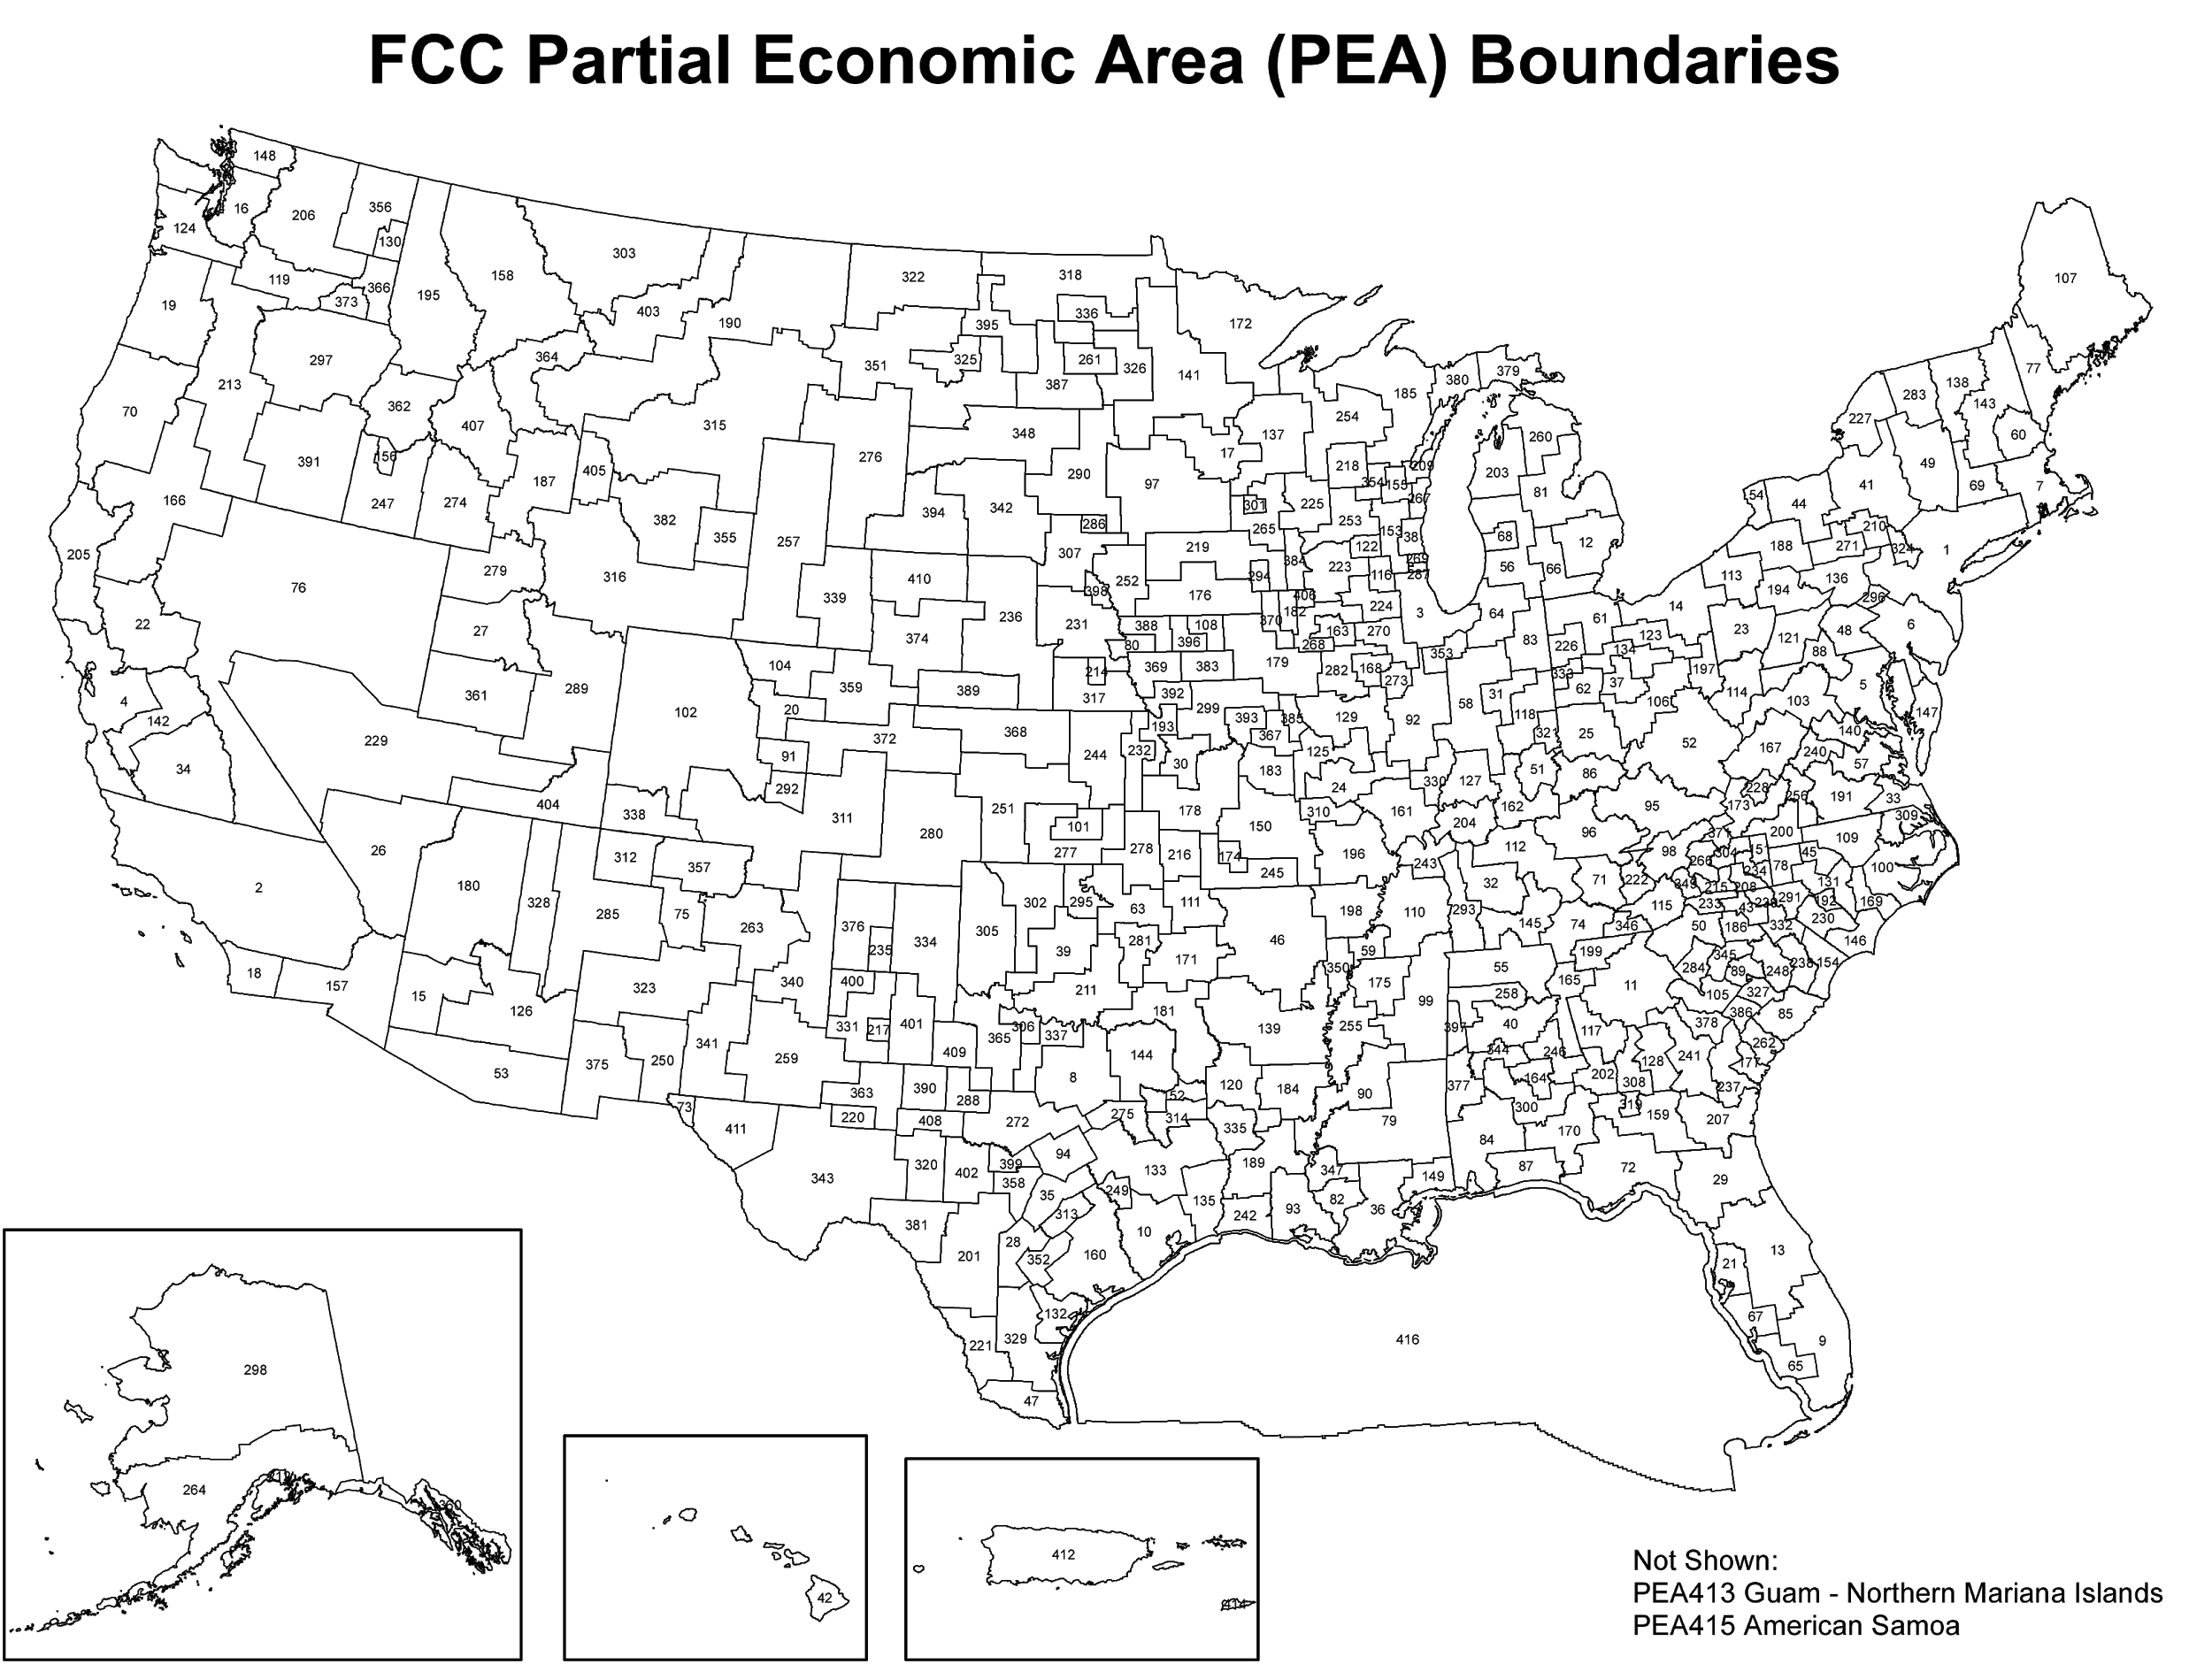
3.7 GHz Auction Completed January 2021
>$80 billion
+ $13 billion clearing costs
Most valuable auction ever
Cleared spectrum, no sharing
High-power operation allowed
328 kW/100 MHz

Slide 7
3.7 GHz Service Band Plan
CBRS 3.55 - 3.7 GHz
3.7 GHz Service
Source: FCC 20-23
Notes:
Earliest (limited) deployments possible early 2021
Phased auction -- earliest phase is bottom 100 MHz

Slide 8
C-band Timeline
December 5, 2021: Phase I voluntary accelerated fixed-satellite clearing deadline
Lower 120 MHz
Satellite operators have agreed to meet the accelerated deadline
December 5, 2023: Phase II voluntary accelerated clearing deadline
Upper 180 MHz
Expectation: Initial 3.7 GHz 5G services starting in late 2021, band fully cleared for more widespread use by late 2023

Slide 9
CBRS Status
Almost exactly one year of full commercial service
>100,000 base station deployments despite pandemic
~100 models of base stations FCC-certified
$4.5 billion raised in PAL auction
PALs not yet deployed -- awaiting FCC to issue licenses
More than 1,700 Certified Professional Installers
Total interference reports: 0

Slide 10
3.45 GHz
Further Notice of Proposed Rulemaking to partially clear government operations and open the band for 5G services
DoD clears as much as possible but retains some constant and some periodic uses in the band
Statutory requirement to auction some or all of the band by EOY 2021
Proposed rules modeled after 3.7 GHz Service
Will new FCC leadership revisit 3.45 GHz?
Extension of CBRS?
Await action on 3.35 to allow for collective action on 3.35-3.55?

Slide 11
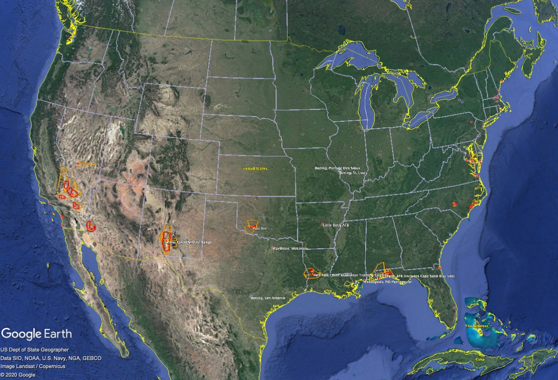
DoD Cooperative Planning Areas (CPAs) and Periodic Use Areas (PUAs)

Slide 12
3.35-3.45 GHz
Gleam in the FCC’s eyes
Larger number of encumbrances compared to 3.45 GHz and CBRS
Status of band TBD

Slide 13
Below 3.35 GHz
No specific plans yet (other than relo of some >3.35 GHz incumbents)

Slide 14
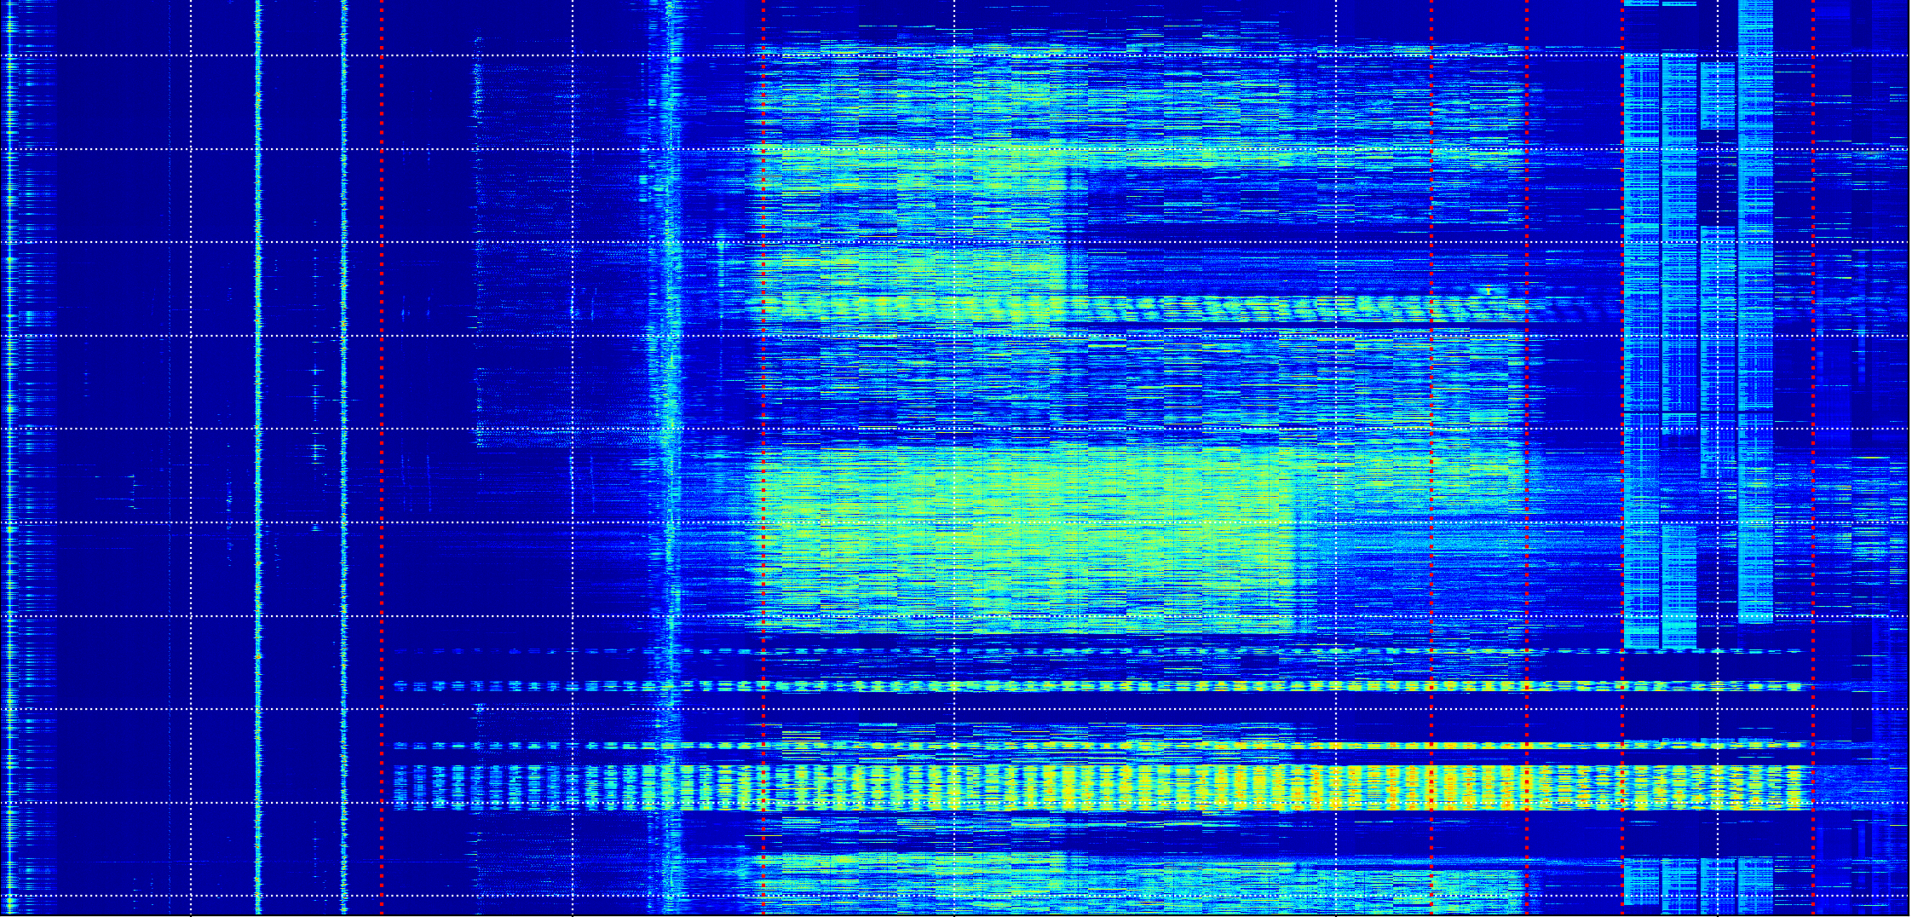
TIME
2.7 GHz
3.7 GHz
Wx/Airport Radar
CBRS
DOD Radar

Slide 15
Midband Max Allowed Radiated Power by Service, to Scale
3450-3550:
3,280 W/MHz (proposed)
3.7 GHz Service:
3,280 W/MHz
Max Allowed EIRP (W/MHz)
CBRS (Cat B): 5 W/MHz
3450
3550
3700
3980

